Slide 1

University of North Texas
CSCE 2110
Foundations of Data Structures
Tree
Notes:
接下来我们进入数据结构中的一个非常重要的主题——树（Tree）。
树是一种 层次型的数据结构，和我们之前学过的线性结构（比如数组、链表、栈、队列）有很大不同。线性结构中的数据都是一条直线式的关系，而树的数据是 分支式、层级式的。

Slide 2
Contents
Tree
Tree Traversal
Binary Trees
Binary Search Tree (BST)
Balanced BST
AVL Tree
Splay Tree (in next slide)
Notes:
我们先会学习树的定义，以及树中的一些基本术语，比如根、父节点、子节点、叶子节点、深度和高度。然后会重点讲 树的遍历（Tree Traversal），包括前序、中序、后序和层序遍历。
在所有树的类型中，二叉树最常用。它的定义和性质比较特殊，也最适合存储和操作。我们会重点理解它的结构和应用。这是二叉树的一个重要变种，支持高效的查找、插入和删除操作。它是很多数据结构和算法的基石。
普通 BST 可能会退化成链表，所以我们需要学习平衡树。
我们会介绍其中一个典型的平衡树：AVL Tree。这是第一种被提出的自平衡二叉查找树。
最后我们会看看另一种自平衡二叉查找树，它通过“伸展”操作保证常见的访问效率。

Slide 3

Nature View of a Tree
leaves
branches
root
Notes:
在学习计算机里的树结构之前，我们先来看看自然界中的树。自然界里的树有几个很明显的部分：
Root（根）：树的底部，它扎在土壤里，提供整个树的基础。没有根，树就没法生长。
Branches（树枝）：从树干不断分出去，连接根和叶子，形成分支结构。
Leaves（树叶）：位于最外层，数量最多，是树的“末端”。

Slide 4
Computer Scientist’s View
root
leaves
branches
node
Notes:
刚才我们用自然界的树做了一个类比，现在我们从计算机科学的角度来重新看树。
在计算机科学家眼里，树不仅仅是根、枝、叶，它更是由 节点（Node） 组成的层次结构。
Root（根节点）：位于最上层，就像自然界的树根，不过在数据结构里它是在“顶部”，是整棵树的入口。
Branches（分支）：对应的是 子节点之间的连接。这些分支把父节点和子节点联系起来。
Leaves（叶子节点）：没有子节点的节点。它们在层级结构的最底层，起到终止作用。
Node（节点）：这是计算机科学家看树的核心概念。
每一个元素就是一个节点，节点可以存储数据，也可以链接到它的子节点。
整棵树就是由这些节点通过指针或引用连接在一起的。

Slide 5
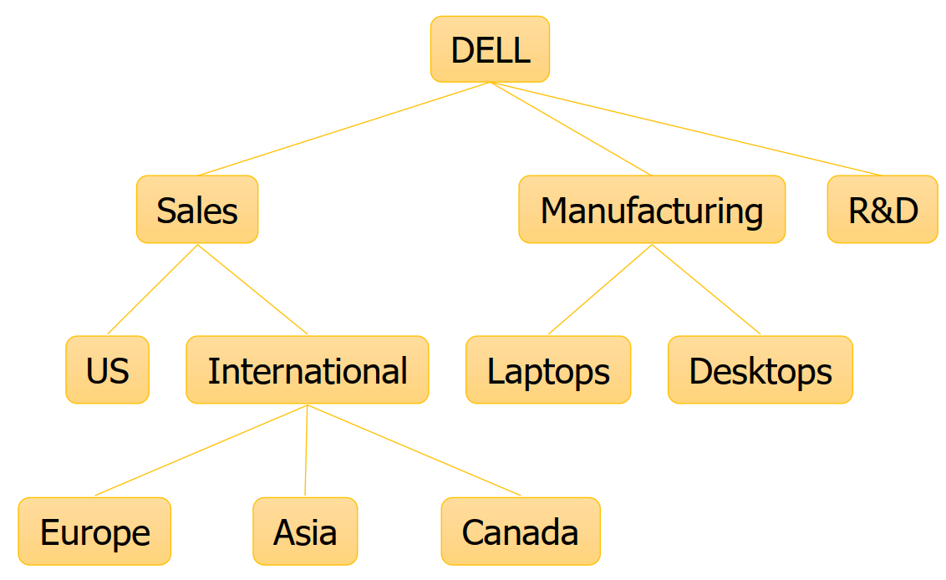
What is a Tree
A tree is a finite nonempty set of elements.
It is an abstract model of a hierarchical structure.
It consists of nodes with a parent-child relation.
Applications:
Organization charts
File systems
Notes:
树是一个有限的非空元素集合
“有限”说明它不可能无限增长；
“非空”表示至少要有一个元素，这个元素就是树的根（root）。
树是层次结构（hierarchical structure）的抽象模型
和我们刚才讲的自然树一样，它表现的是从上到下的层级关系。
在树中，每一层的节点都有清晰的上下关系，而不是像线性表那样“一条直线”。
树由节点（nodes）组成，并且节点之间存在父子关系（parent-child relation）
每个节点可以有“父亲”和“孩子”。
根节点没有父亲，叶子节点没有孩子。
这种父子关系形成了整棵树的结构。

Slide 6
Definition and Tree Trivia
Recursive Definition of a Tree:
A tree is a set of nodes that is
(a) an empty set of nodes, or
(b) has one node called the root from which zero or more trees (subtrees) descend.
A tree with 𝑁 nodes always has edges

Slide 7
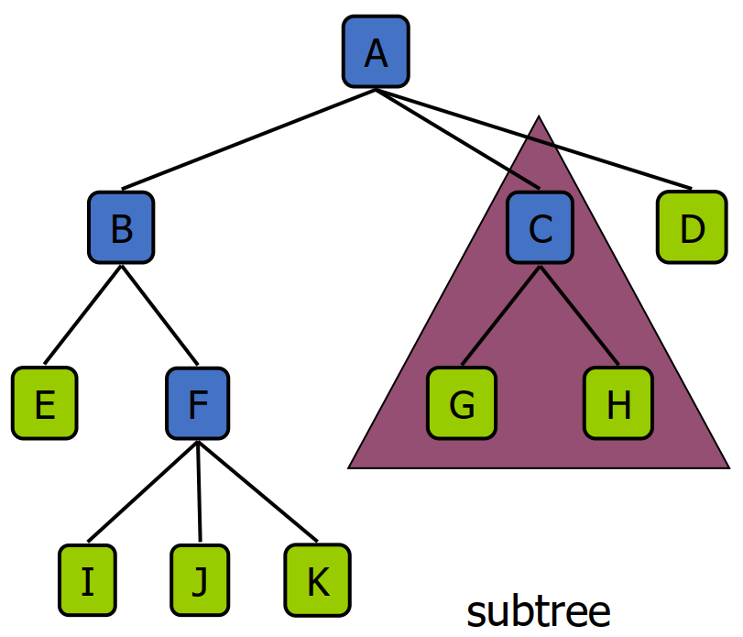
Tree Terminology
Root: node without parent (A)
Siblings: nodes share the same parent
Internal node: node with at least one child (A, B, C, F)
External node (leaf): node without children (E, I, J, K, G, H, D)
Ancestors of a node: parent, grandparent, grand-grandparent, etc.
Descendant of a node: child, grandchild, grand- grandchild, etc.
Depth of a node: number of ancestors
Height of a node: number of edges on the longest path from the node to a leaf
Height/Depth of a tree: maximum depth of any node
Degree of a node: the number of its children
Degree of a tree: the maximum degree of its node.
Subtree: tree consisting of a node and its descendants
Notes:
Root（根节点）
没有父节点的节点，比如图中的 A。整棵树就是从根节点开始的。
Siblings（兄弟节点）
拥有相同父节点的节点，比如 B、C、D 是兄弟节点。
Internal Node（内部节点）
至少有一个子节点的节点，比如 A, B, C, F。
External Node / Leaf（外部节点 / 叶子节点）
没有子节点的节点，比如 E, I, J, K, G, H, D。
Ancestors（祖先节点）
一个节点的父亲、祖父、曾祖父等。例如，B 是 I 的祖先，A 也是 I 的祖先。
Descendants（后代节点）
一个节点的孩子、孙子、曾孙。例如，I、J、K 是 B 的后代。
Depth of a Node（节点的深度）
指该节点到根节点路径上边的数量。
根节点的深度是 0。比如 A 的深度是 0，B 的深度是 1，I 的深度是 3。
Height of a Node（节点的高度）
从该节点到叶子节点的最长路径上的边数。
比如 B 的高度是 2（经过 F → I/J/K）。
Height / Depth of a Tree（树的高度 / 深度）
树中所有节点的最大深度，也就是根节点的高度。
Degree of a Node（节点的度）
一个节点的子节点数。比如 C 的度是 2，因为它有 G 和 H。
Degree of a Tree（树的度）
所有节点的度中的最大值。
Subtree（子树）
由某个节点和它所有后代节点组成的部分树。例如，以 C 为根的部分（包含 G 和 H）就是一棵子树。

Slide 8
YMTT (Yet More Tree Terminology)
Binary tree: each node has at most two children
𝑛-ary trere: each child has at most n children
Complete tree: Each row of the tree is filled in left to right before the next one is started
How deep can a complete binary tree (with n nodes) be?
Notes:
等比数列的英文叫：Geometric sequence
max: 2^(h+1)-1
min: (2^h-1)+1

Slide 9
Tree ADT
We use positions to abstract nodes
Query methods:
integer size()
boolean isEmpty()
objectIterator elements()
positionIterator positions()
position root()
position parent(p)
positionIterator children(p)
Update methods:
insert(p)
delete(p)
swapElements(p, q)
object replaceElement(p, o)
Additional update methods may be defined by data structures implementing the Tree ADT

Slide 10
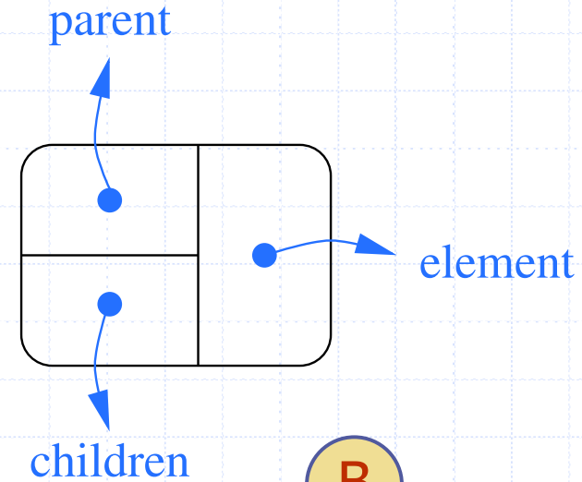

A Tree Representation
A node is represented by an object storing
Element
Parent node
Sequence of children nodes
// A node of N-ary tree
struct node {
char element;
node * parent;
node * child[N];
};
Notes:
在计算机里，一棵树就是由一组 节点（nodes） 构成的，而每个节点通常存储三个部分的信息：
Element（元素）：节点里实际存放的数据，比如一个整数、一个字符或者对象。
Parent node（父节点指针）：指向它的父节点。这样我们就可以从任意节点往上追溯。
Sequence of children nodes（子节点集合）：指向它的所有子节点。这样就能往下延伸形成整棵树。

Slide 11
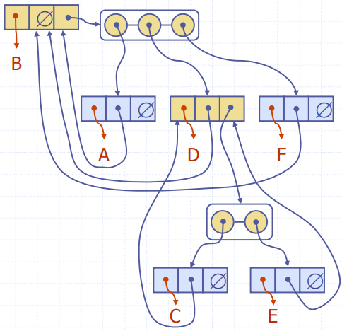
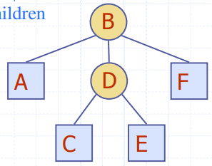
A Tree Representation

Slide 12
Tree Traversals
Walking through a tree is called a traversal
Common kinds of traversal
Pre-order: node, then children
Post-order: children, then node
In-order: left, then node, then right (specific to binary trees)
Level-order: nodes at depth d, nodes at depth d+1, …
Notes:
在操作树的时候，一个最常见的问题就是：如何访问树中的所有节点？这个过程就叫 遍历（traversal）。遍历就是按照某种顺序“走一遍”树，把每个节点都访问一次。
常见的遍历方式
Pre-order Traversal（前序遍历）访问顺序：节点 → 子节点 先访问根节点，再访问它的子节点。
Post-order Traversal（后序遍历）访问顺序：子节点 → 节点 先访问所有子节点，最后访问根节点。
In-order Traversal（中序遍历，特定于二叉树）访问顺序：左子树 → 节点 → 右子树
访问顺序：按照树的层次，一层一层访问。
从深度 $d$的所有节点开始，再到深度 $d+1$的所有节点，以此类推。

Slide 13
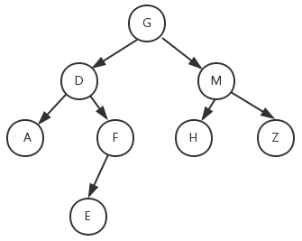
Tree Traversals

Slide 14
Tree Traversals
Pre-order:
G D A F E M H Z
Post-order:
A E F D H Z M G
In-order:
A D E F G H M Z

Slide 15
Tree Traversals
Pre-order:
A B D E G C F
In-order:
D B G E A C F
Post-order:
?

Slide 16
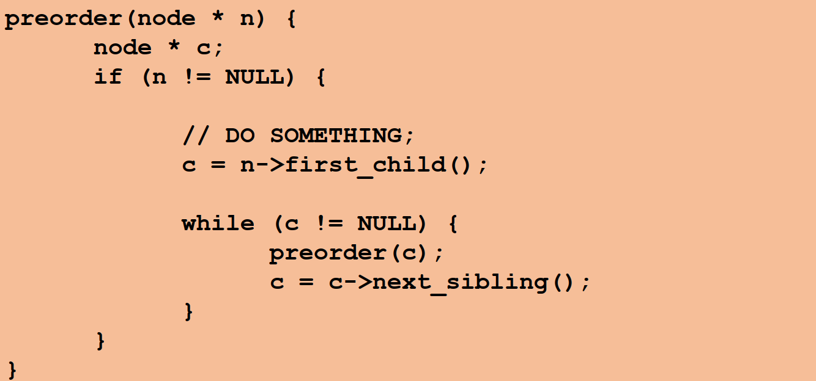
Pre-Order Traversal
Perform computation at the node, then recursively perform computation on each child

Slide 17
Pre-Order Applications
Use when computation at node depends upon values calculated higher in the tree (closer to root)
Example: computing depth
The depth of a node is the number of edges from the node to the tree's root node
depth(node) = 1 + depth( parent of node )

Slide 18
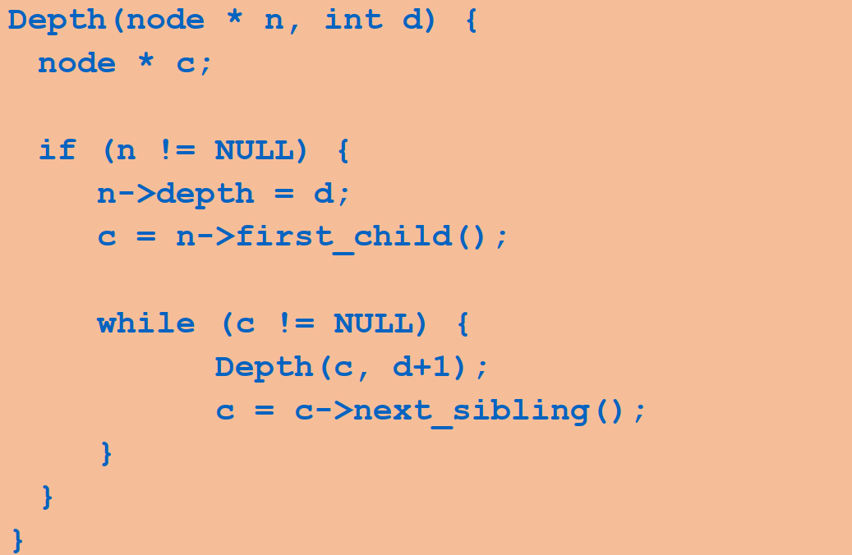
Pre-Order Example: Computing Depth of All Nodes
Add a field depth to all nodes
Call Depth(root,0) to set depth field

Slide 19
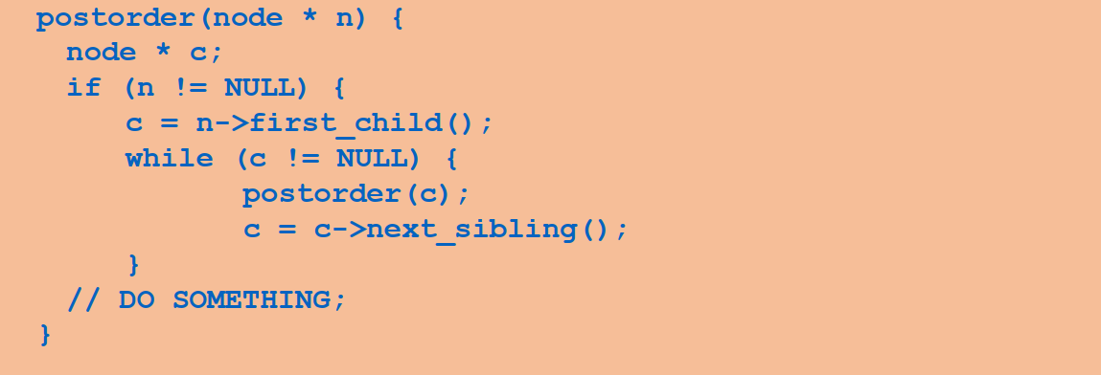
Post-Order Traversal
Recursively perform computation on each child, then perform computation at node

Slide 20
Post-Order Applications
Use when computation at node depends on values calculated lower in tree (closer to leaves)
Example: computing height
The height of a node is the number of edges on the longest path from the node to a leaf.
A leaf node will have a height of 0.
height(node) = 1 + MAX( height(child₁), … height(child_{k}) )
Example: size of tree rooted at node
size(node) = 1 + size(child₁) + … + size(child_{k})

Slide 21
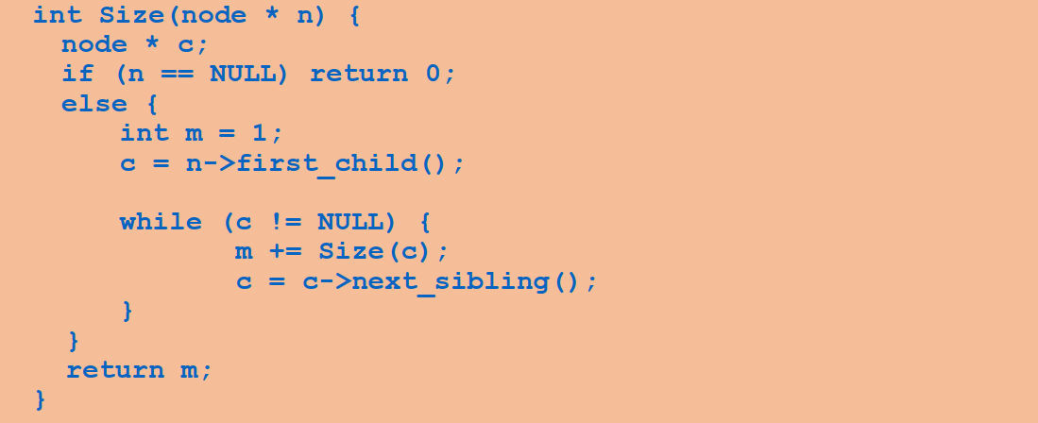
Post-Order Example: Computing Size of Tree
Call Size(root) to compute number of nodes in tree

Slide 22
Depth-First Search
Pre-Order and Post-Order traversals are examples of depth-first search:
Nodes are visited deeply on left-most branches before any nodes are visited on right-most branches
NOTE: visiting right deeply before left would still be depth-first - crucial idea is “go deep first”
In DFS the nodes “being worked on” are kept on a stack (where?)

Slide 23
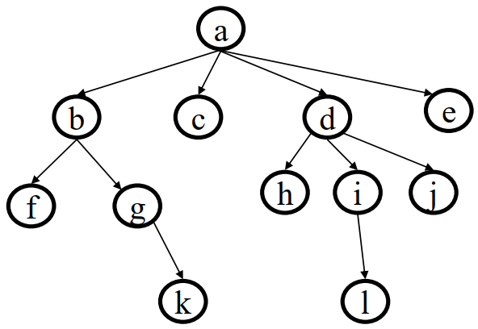
Level-Order (Breadth-First) Traversal
Consider task of traversing tree level-by-level from top to bottom (alphabetic order, in example below)
Notes:
首先，我们要明确什么是层次遍历。 在树的遍历中，常见的有 前序、中序、后序 三种深度优先遍历方式。而层次遍历的思路不一样，它不是沿着一条分支一直走到尽头，而是 一层一层地访问，从根节点开始，依次访问同一层的所有节点，再进入下一层。
换句话说：从 上到下，从 左到右，依次访问树中的节点。

Slide 24
Level-Order (Breadth-First) Traversal
Consider task of traversing tree level-by-level from top to bottom (alphabetic order, in example below)
Which data structure can best keep track of nodes?
Notes:
那么问题来了： 当我们在访问时，如何才能保证顺序不乱？我们需要一种合适的数据结构，来帮我们 记录节点访问的顺序。
答案就是 队列（Queue）。

Slide 25
Level-Order (Breadth-First) Algorithm
Put root in a Queue
Repeat until Queue is empty:
Dequeue a node
Process it
Add its children to queue
Notes:
现在我们来看看广度优先遍历的具体算法步骤。
第一步，把树的 根节点 放入队列。这是整个遍历的起点。没有根节点，就没有后续的层次。
接下来，我们进入一个循环，直到队列为空。循环中要做三件事：
Dequeue 一个节点 —— 从队列头部取出一个节点。
Process it —— 访问这个节点。“访问”在不同场景下可以有不同的含义，比如打印它的值、记录下来，或者执行某个操作。
Add its children to queue —— 把它的子节点依次加入队列尾部。
当队列为空时，说明树的所有节点都已经被访问过了，遍历结束。

Slide 26
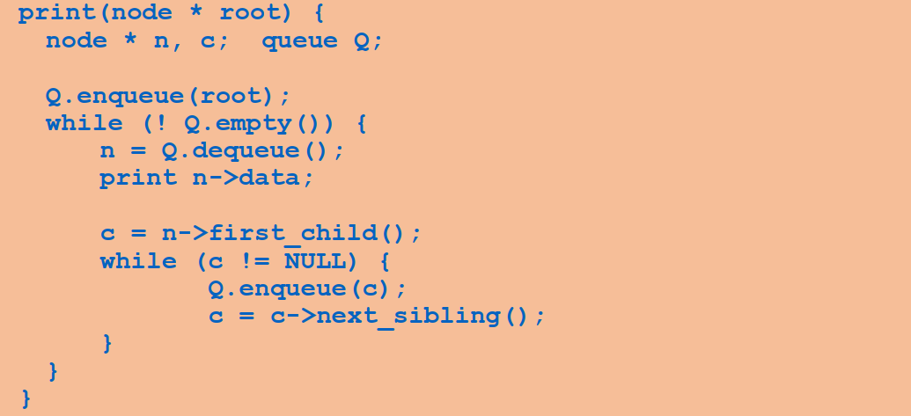
Level-Order Example: Printing the Tree
Call Print(root) to print tree contents

Slide 27
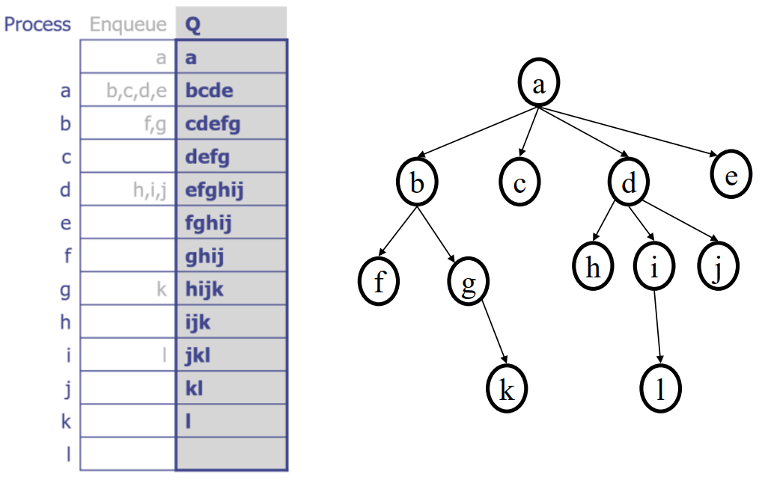
Example: Level-Order Queue
Put root in a Queue
Repeat until Queue is empty:
Dequeue a node
Process it
Add its children to queue

Slide 28
Example: Level-Order Queue

Slide 29
Applications of Breadth-First Search
Find shortest path from root to a given node N
if node N is at depth k, BFS will never visit a node at depth > k
important for really deep trees
Generalizes to finding shortest paths in graphs
Spidering the world wide web
From a root URL, fetch pages that are farther and farther away

Slide 30
Binary Search Tree
Binary Search Trees (BST) are a type of Binary Trees with a special organization of data.
Every element has a unique key.
The keys in the nonempty left subtree (right subtree) are smaller (larger) than the key in the root of subtree (BST property)
The left and right subtrees are also binary search trees.
Notes:
现在我们来学习一种非常重要的数据结构：二叉搜索树（Binary Search Tree，简称 BST）。
唯一键值（Unique Key）树中的每个节点都包含一个唯一的关键字（key），不能重复。
BST 属性（BST Property）在某个节点的 左子树 中，所有节点的关键字都 小于 该节点的关键字。在某个节点的 右子树 中，所有节点的关键字都 大于 该节点的关键字。
递归定义 一棵 BST 的左子树和右子树，本身也是 BST。也就是说，这个性质在整棵树上层层递归成立。
可以给出一些例子给学生

Slide 31
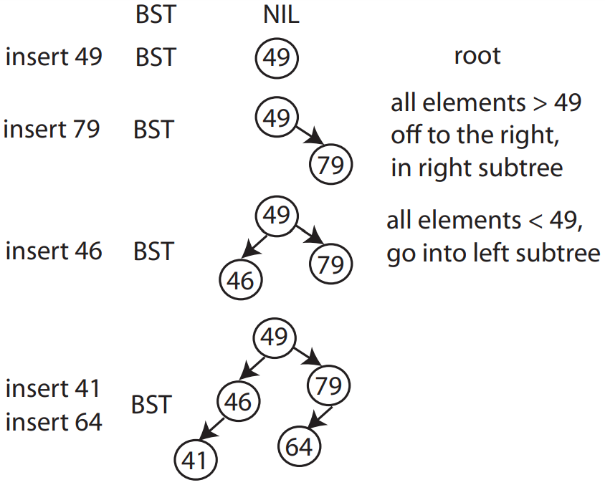
Binary Search Trees (BST)
Insertion: insert(val)
typedef struct BinaryNode {
int key;
BinaryNode *right; BinaryNode *left;
}ptnode;
Notes:
要看 BST 最基本的一个操作：插入（Insertion）。
插入操作其实就是在保持 BST property 的前提下，把一个新元素放到正确的位置。 规则非常简单：如果新元素 小于当前节点的值，就往左子树走；如果新元素 大于当前节点的值，就往右子树走；一直递归或迭代，直到找到空位置，把新节点放进去。
可以给出一些例子给学生

Slide 32
Insertion into a BST
void insert (ptnode * & node, int key){
if (!node){
node = (ptnode) malloc(sizeof(ptnode));
node->key = key;
node->left = node->right = NULL;
} else if (key < node->key)
{
insert(node->left, key);
} else if (key > node->key)
{
insert(node->right, key);
}
}

Slide 33
Finding a value in the BST if it exists: find(val)
Follow left and right pointers until you find it or hit NULL.
Search in BST – Pseudocode
if the tree is empty
return NULL
else if the item in the node equals the target
return the node value
else if the item in the node is greater than the target
return the result of searching the left subtree
else if the item in the node is smaller than the target
return the result of searching the right subtree
Notes:
现在我们来学习二叉搜索树中的另一个基本操作：查找 (Search)。
第一种情况：如果树是空的，直接返回 NULL。
第二种情况：如果当前节点的值等于目标，返回结果。
第三种情况：如果当前节点比目标大，就往左子树查找。
第四种情况：如果当前节点比目标小，就往右子树查找。
可以给出一些例子给学生

Slide 34
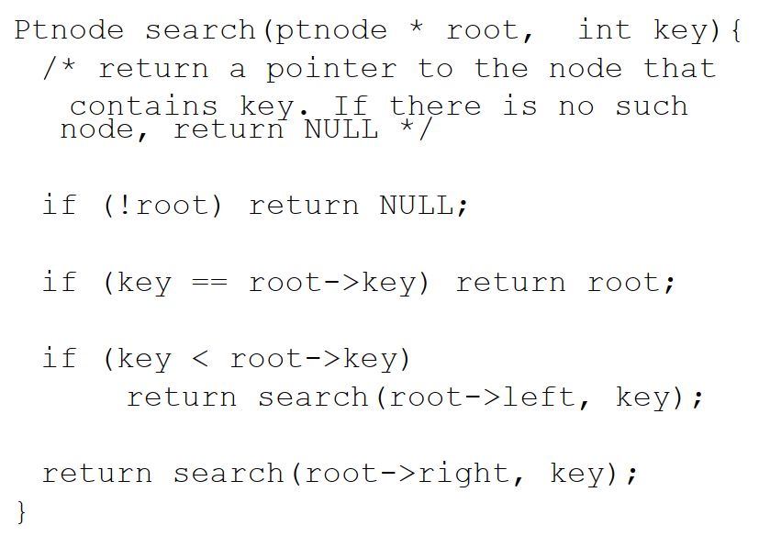
Search in a BST

Slide 35
Finding the minimum element in a BST: findmin()
How?

Slide 36
Finding the minimum element in a BST: findmin()
Key is to just go left till you cannot go left anymore.

Slide 37
BST Operations: Removal
uses a binary search to locate the target item:
starting at the root it probes down the tree till it finds the target or reaches NULL
removal of a node must not leave a ‘gap’ in the tree,
Notes:
二叉搜索树中最复杂的基本操作——删除 (Removal)
查找要删除的节点
删除的第一步，其实和查找一样：
从根节点开始，按照目标值和当前节点的大小关系，逐步往左或右子树走，直到找到目标节点，或者走到 NULL（说明树中不存在这个值）。
第二步，找到目标节点后，我们要分三种情况来处理：

Slide 38
Removal in BST - Pseudocode
if the tree is empty return false
Attempt to locate the node containing the target using the binary search
if the target is not found return false
else the target is found, so remove its node:
Case 1: if the node has 2 empty subtrees
― replace the link in the parent with null
Case 2: if the node has a left and a right subtree
― replace the node's value with the max value in the left subtree
― delete the max node in the left subtree

Slide 39
Removal in BST - Pseudocode
if the tree is empty return false
Attempt to locate the node containing the target using the binary search
if the target is not found return false
else the target is found, so remove its node:
Case 3: if the node has no left child
― link the parent of the node to the right (non- empty) subtree
Case 4: if the node has no right child
― link the parent of the target to the left (non- empty) subtree
Notes:
删除操作要维护 BST 的有序性，不能留下 “gap”。

Slide 40
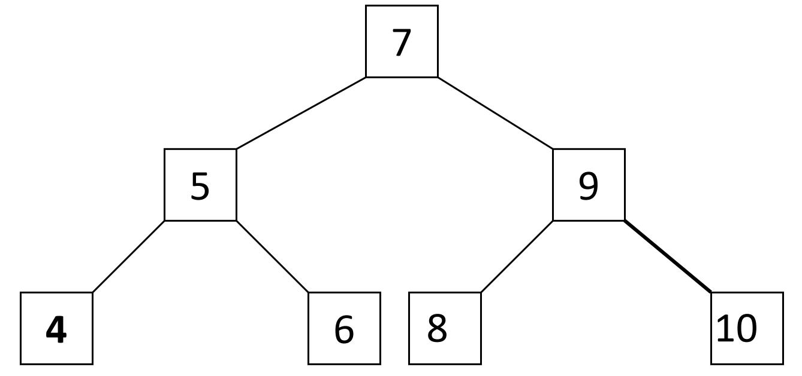
Removal in BST: Example
Use the algorithm to delete an item.
Delete 9?
Delete 7?
Delete 10?

Slide 41
Removal in BST: Example
Case 1: removing a node with 2 EMPTY SUBTREES
parent
7
cursor
5
9
4
6
8
10
Removing 4

Slide 42
Removal in BST: Example
Case 1: removing a node with 2 EMPTY SUBTREES
parent
7
cursor
5
9
4
6
8
10
7
Removing 4
replace the link in the parent with null
after removal
5
9
6
8
10

Slide 43
Removal in BST: Example
Case 2: removing a node with 2 SUBTREES
Removing 7
cursor
7
5
9
4
6
8
10

Slide 44
Removal in BST: Example
Case 2: removing a node with 2 SUBTREES
replace the node's value with the max value in the left subtree
delete the max node in the left subtree
Removing 7
cursor
cursor
7
6
5
9
5
9
4
6
8
10
4
8
10
after removal

Slide 45
Removal in BST: Example
Case 2: removing a node with 2 SUBTREES
replace the node's value with the max value in the left subtree
delete the max node in the left subtree
What element else
can be used as
replacement?
Removing 7
cursor
cursor
7
6
5
9
5
9
4
6
8
10
4
8
10
after removal

Slide 46
Removal in BST: Example
Case 3: removing a node with 1 EMPTY SUBTREE
Removing 5
parent
7
cursor
5
9
6
8
10

Slide 47
Removal in BST: Example
Case 3: removing a node with 1 EMPTY SUBTREE
the node has no left child: link the parent of the node to the right (non-empty) subtree
Removing 5
parent
parent
7
7
cursor
5
9
cursor
5
9
6
8
10
6
8
10
after removal

Slide 48
Removal in BST: Example
Case 4: removing a node with 1 EMPTY SUBTREE
Removing 5
parent
7
cursor
5
9
4
8
10

Slide 49
Removal in BST: Example
Case 4: removing a node with 1 EMPTY SUBTREE
the node has no right child:
link the parent of the node to the left (non-empty) subtree
Removing 5
parent
parent
7
cursor
7
cursor
5
9
5
9
4
8
10
4
8
10
after removal

Slide 50
Analysis of BST Operations
The complexity of operations search, insert and remove in BST is 𝑂(ℎ) , where ℎ is the height.
𝑂(log 𝑛) when the tree is balanced, i.e., ℎ = 𝑂(log 𝑛). The updating operations may cause the tree to become unbalanced.
The tree can degenerate to a linear shape and the operations will become 𝑂(𝑛)
Notes:
在二叉搜索树（Binary Search Tree, BST）中，三类基本操作：search（查找）insert（插入）remove（删除）
它们的时间复杂度取决于树的高度 $h$。复杂度为：$O\left(h\right)$。
当 BST 保持平衡时，高度约为：$h=O\left(\log{n}\right)$
但是注意：插入和删除操作可能会破坏平衡，导致树不再是理想的对数高度。
如果树逐渐退化为一条线性链（类似链表），高度变为：h=O(n); 此时操作复杂度变为：O(n)

Slide 51
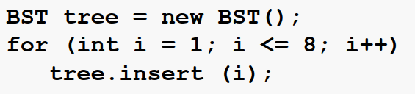
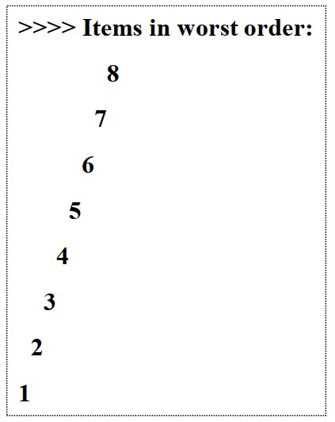
Worst Case
Output

Slide 52
Balanced BSTs
Prevent the degeneration of the BST :
A BST can be set up to maintain balance during updating operations (insertions and removals)
To achieve a worst-case runtime of 𝑂(log 𝑛) for searching, inserting and deleting, h = 𝑂(log 𝑛)
Two types we’ll look at :
AVL trees (named after inventors Adelson-Velsky and Landis)
splay trees
There are many other types of balanced BSTs: 2-4 trees, Red-Black trees, B-trees

Slide 53
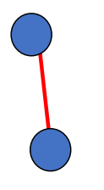
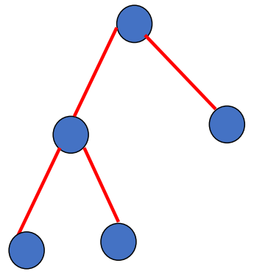
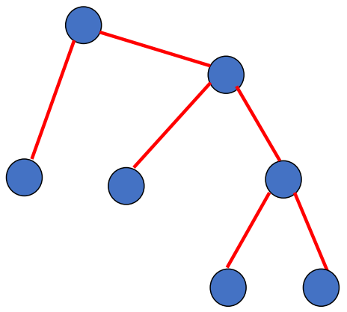
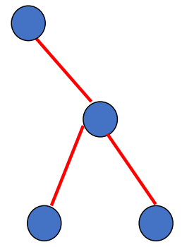
AVL Trees
Invented in 1962 by Russian mathematicians Adelson-Velsky and Landis
An AVL tree is a binary search tree such that (AVL property):
The height of the left and right sub-trees of the root differ by at most 1 (balanced)
The left and right sub-trees are AVL trees
treat nil tree as height -1
Which of these are AVL trees, assuming that they are BSTs?

Slide 54
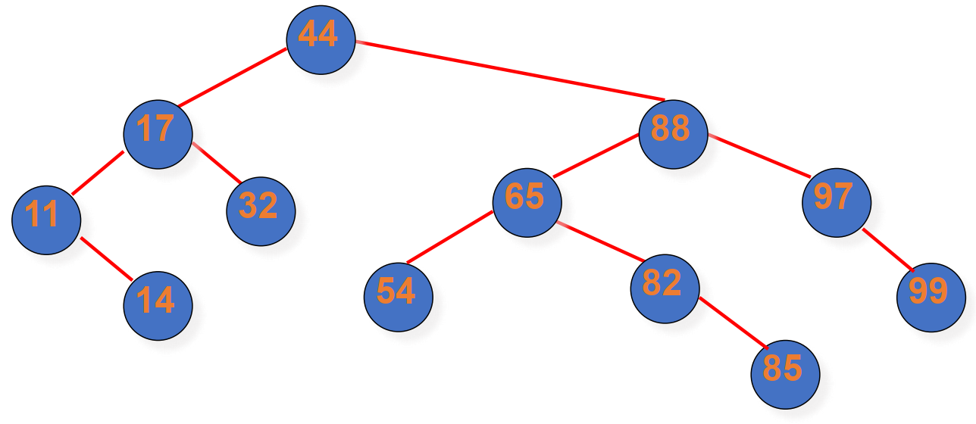
Valid AVL Tree
Note: it is not a requirement that all leaves be on the same or adjacent level

Slide 55
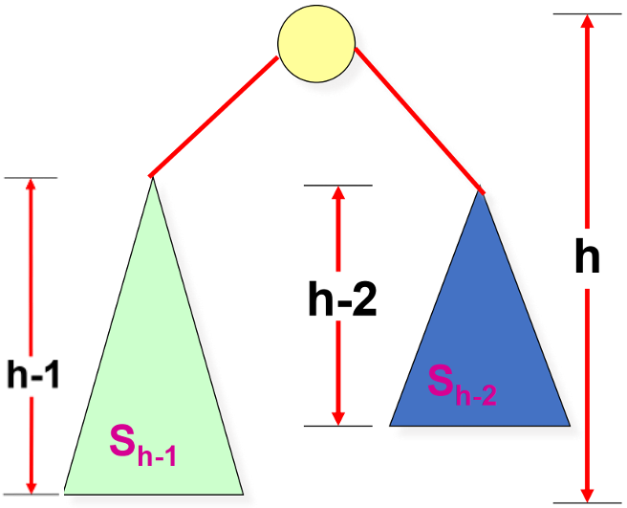
AVL Trees: Balanced
Aim to get a tight upper bound for ℎ
Worst when the height of the left and right sub-trees of every node differs by 1
let 𝑁_{ℎ} = (𝑚𝑖𝑛.) # nodes in height-ℎ AVL tree
𝑁_{ℎ} = 𝑁_{ℎ−1} + 𝑁_{ℎ−2} + 1
> 2𝑁_{ℎ−2}
𝑁_{ℎ} > 2^{ℎ/2}
ℎ < 2 log 𝑁_{ℎ}

Slide 56
AVL Trees: Balanced
Based on 𝑁_{ℎ} = 𝑁_{ℎ−1} + 𝑁_{ℎ−2} + 1, we can have 𝑁_{ℎ−1} as follows by replacing h with h-1
𝑁_{ℎ-1} = 𝑁_{ℎ−2} + 𝑁_{ℎ−3} + 1
We can plug 𝑁_{ℎ-1} into 𝑁_{ℎ}, and obtain the following
𝑁_{ℎ} = 𝑁_{ℎ−1} + 𝑁_{ℎ−2} + 1 = (𝑁_{ℎ−2} + 𝑁_{ℎ−3} + 1)+ 𝑁_{ℎ−2} + 1 = 2𝑁_{ℎ−2} + 𝑁_{ℎ−3} + 2
So, we have 𝑁_{ℎ} > 2𝑁_{ℎ−2.} We can replace h with h-2, obtaining 𝑁_{ℎ-2} > 2𝑁_{ℎ−4}
We can plug the above into 𝑁_{ℎ} > 2𝑁_{ℎ−2} to obtain the following
𝑁_{ℎ} > 2𝑁_{ℎ−2} > 2×2𝑁_{ℎ−4} => 𝑁_{ℎ} > 2²𝑁_{ℎ−2×2} => 𝑁_{ℎ} > 2^{k}𝑁_{ℎ−2k}
When h-2k = 0, i.e., k = h/2, we have
𝑁_{ℎ} > 2^{h/2}𝑁₀ => 𝑁_{ℎ} > 2^{h/2} => log(𝑁_{ℎ}) > h/2 => 2log(𝑁_{ℎ}) > h
With h < 2log(𝑁_{ℎ}), we can easily get h=O(log(𝑁_{ℎ})) using the definition of big O.

Slide 57
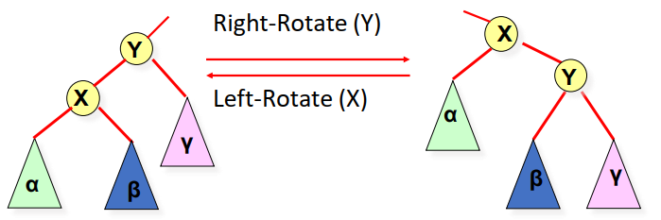
Rotations
Rotations maintain the ordering property of BSTs.
A rotation is an O(1) operation

Slide 58
AVL Insert
(1) insert as in simple BST
(2) walk your way up tree, restoring AVL property (and updating heights as you go).
suppose x is the lowest node violating AVL
assume x is right-heavy – right subtree has larger height (left case symmetric)
two cases:
Case 1: x’s right child is right-heavy or balanced → single left rotation on x
Case 2: else → double rotations (right rotation on right child, then left rotation on x)
then continue up to x’s parent, grandparent, grandgrandparent . . .

Slide 59
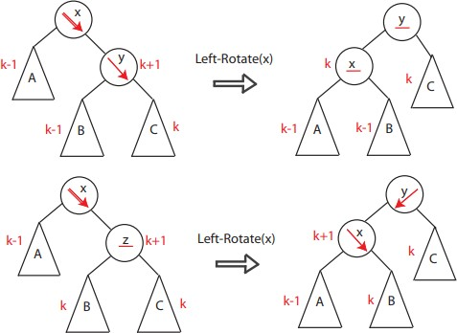
Case 1

Slide 60
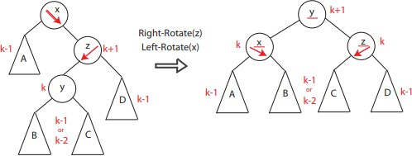
Case 2

Slide 61
Restructuring
The four ways to rotate nodes in an AVL tree, graphically represented
-Single Rotations:
c = z
single rotation
b = y
b = y
a = x
c = z
a = x
T
T
3
0
T
T
T1
T
T
0
2
2
3
T
1

Slide 62
Restructuring (cont’d)
double rotations:
c = z
double rotation
b = x
a = y
a = y
c = z
b = x
T
0
T
1
T
3
T
2
T
0
T
2
T
3
T
1

Slide 63
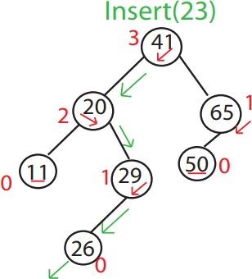
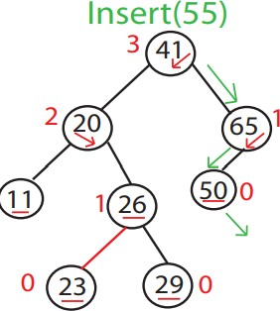
Example

Slide 64
Balancing AVL tree
void balance( AvlNode * & t ) {
if( t == NIL ) return;
if( height( t->left ) - height( t->right ) > 1)
if( height( t->left->left ) >= height( t->left->right ) )
rotateWithLeftChild( t );
else
doubleWithLeftChild( t );
else if( height( t->right ) - height( t->left ) > 1)
if( height( t->right->right ) >= height( t->right->left ) )
rotateWithRightChild( t );
else
doubleWithRightChild( t );
t->height = max( height( t->left ), height( t->right ) ) + 1;
}

Slide 65
Balancing AVL tree
void rotateWithLeftChild( AvlNode * & k2 ) {
AvlNode *k1 = k2->left;
k2->left = k1->right;
k1->right = k2;
k2->height = max( height( k2->left ), height( k2->right ) ) + 1; k1->height = max( height( k1->left ), k2->height ) + 1;
k2 = k1;
}

Slide 66
Comments
In general, process may need several rotations before done with an Insert. 𝑂(log 𝑛) rotations may be required
Deletion is similar — harder but possible.
Running time for inserting each item into AVL tree?

Slide 67
Advantages/Disadvantage of AVL Trees
Advantages
𝑂(log 𝑛) worst-case searches, insertions and deletions
Disadvantages
Complicated Implementation
Must keep balancing info in each node
To find node to balance, must go back up in the tree: easy if pointer to parent, otherwise difficult
Deletion complicated by numerous potential rotations

